Slide 1
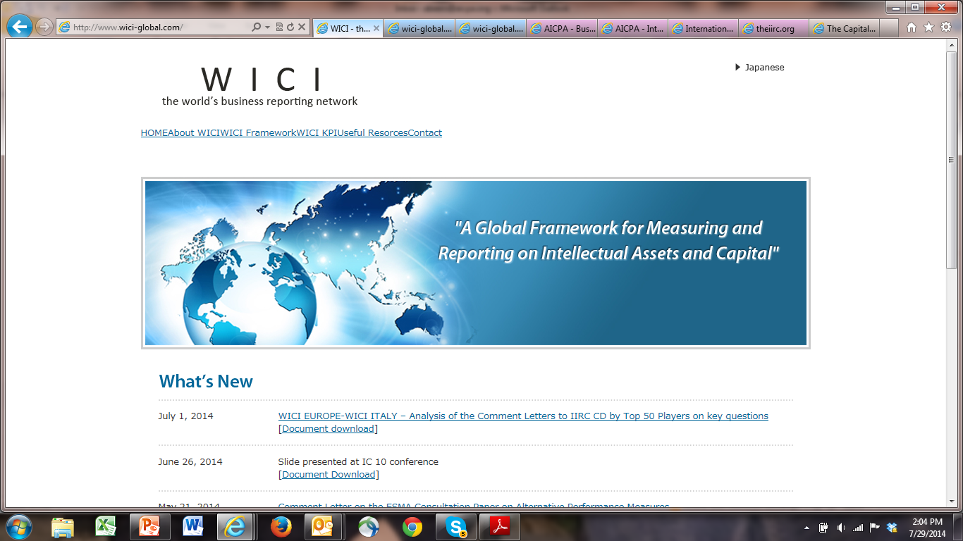

World Intellectual Capital/Assets Initiative
Amy Pawlicki
Chair, WICI Global
WICI Italy/NIBR International Seminar:
KPIs, Non-Financial Information & Corporate Value Creation
November 17, 2014
Milan, Italy

Slide 2
Current Business Reporting Model
Adopted during, and to meet the needs of, the industrial age
Based on assumptions that profitability is driven by tangible assets such as physical plant and equipment and raw materials that are needed to produce tangible products
Compliance-based
One-size-fits-all model with an exclusively historical financial statement focus
Static, paper-based, summary-level reports
Notes:
The foundation for the current external financial reporting model (that is, US GAAP and other equivalents like IFRS) was adopted during, and to meet the needs of, the industrial age. It is, to a large extent, based on the assumption that profitability is driven by tangible assets such as physical plant and equipment and raw materials that are needed to produce tangible products. This model was not designed to describe the vast array of new business models that companies now follow in the knowledge economy—business models that, in many cases, rely heavily on the employment of intangible assets to create value and drive profitability.

Slide 3
Business Reporting Must Adapt to Change
Capital must be redeployed quickly
Technology has enabled rapid change and increased competition
Business reporting critical to capital allocation
Therefore, business reporting must change:
  Forward-looking information
  Focus on long-term value
  Alignment of internal and external business reporting
Notes:
Increased competition and rapid advances in technology are resulting in dramatic changes. To survive and compete, companies are changing everything — the way they are organized and managed, the way they do work and develop new products, the way they manage risks, and their relationships with other organizations.
In response to increased competition and changes in their businesses, companies also are changing their information systems and the types of information they use to manage their businesses. For example, they are developing new performance measures often designed to focus on activities that provide long-term value and competitive advantage, including non- financial measures such as product development lead time and financial measures such as economic value added. (Source: Jenkins Report)

Slide 4
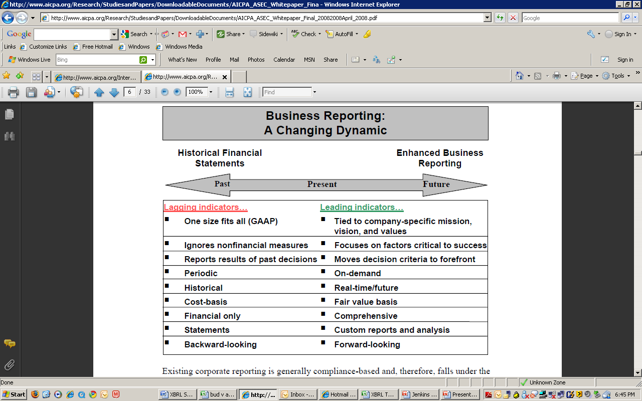
Evolution of Corporate Reporting
Notes:
While all enterprises (including those in industries that primarily deal in tangibles, such as agricultural, manufacturing, and distribution, among others) have progressed to become more global, highly automated, and increasingly reliant on intangible value drivers rather than physical assets alone, the reporting model has not adapted at the same pace as illustrated in this diagram.
While the current model does serve as an effective foundation from which business reporting should start, timely decisions can be made only by looking at both lagging indicators (such as those found in historical financial statements) and leading indicators (such as value drivers and key performance indicators), which provide more predictive information about the future cash flows and viability of the business. Whereas the current reporting model is a one-size-fits-all model with an exclusively historical financial statement focus, an enhanced reporting model would allow for better decision making through up-to-date information on mission, vision, value drivers, and critical success factors, which are all relevant measures that speak to future potential. This is the kind of information that management currently uses to make key decisions, and yet there is a disconnect in the corporate reporting process between the information management uses internally for decision making purposes and what is provided externally to the marketplace for its decision making.
(Source: ASEC Whitepaper)

Slide 5

Greatest Barriers to the
Evolution of Corporate Reporting
Market and Regulatory drivers:
Short-termism, focus on quarterly earnings
Fear of liability (primarily in the US)
Lack of regulatory mandate
  Inertia is the name for the tendency of an object in motion to remain in motion, or an object at rest to remain at rest, unless acted upon by a force.
Notes:
Full list of perceived barriers to the evolution of corporate reporting:
Short-termism
Lack of regulatory mandate
Perceived compliance burden
Perceived competitive disadvantage
Fear of liability/litigation risk
Lack of a structured reporting framework
Concern around ability to provide assurance on non-financial information
Perceived lack of technological capabilities
The concept of inertia was quantified in Newton's First Law of Motion: Every body continues in its state of rest, or of uniform motion in a straight line, unless it is compelled to change that state by forces impressed upon it.

Slide 6
Greatest Barriers to the
Evolution of Corporate Reporting (2)
Other factors contributing to resistance to voluntary change:
Former lack of a globally accepted, structured reporting framework
Disclosure overload/compliance burden
Desire to monetarily value and/or rate/rank everything, misguided perception of measurement certainty, failure to understand the mechanics of valuation
Valuation is both an
Art and a Science
Notes:
Leonardo Da Vinci was an Italian polymath, painter, sculptor, architect, musician, mathematician, engineer, inventor, anatomist, geologist, cartographer, botanist, and writer.

Slide 7
INTERNATIONAL PICTURE OF CORPORATE REPORTING
FINANCIAL REPORTING
NATIONAL
VALUATION BODIES
EFRAG/OIC/ANC/GASB/FASB/ASB-FRC
ACCOUNTING
IASB
VALUATION
IVSC
X
B
R
L
IIRC
(CRD)
SUSTAINABILITY
(ENVIRONMENTAL/SOCIAL)
GRI
UN GLOBAL COMPACT
PRI / CDSB / CDP / SASB
VALUE CREATION
(INTANGIBLES/
KEY VALUE DRIVERS)
WICI
WICI EUROPE /JAPAN / USA / ITALY /
FRANCE / GERMANY
NATIONAL SUSTAINABILITY BODIES
NON-FINANCIAL REPORTING

Slide 8
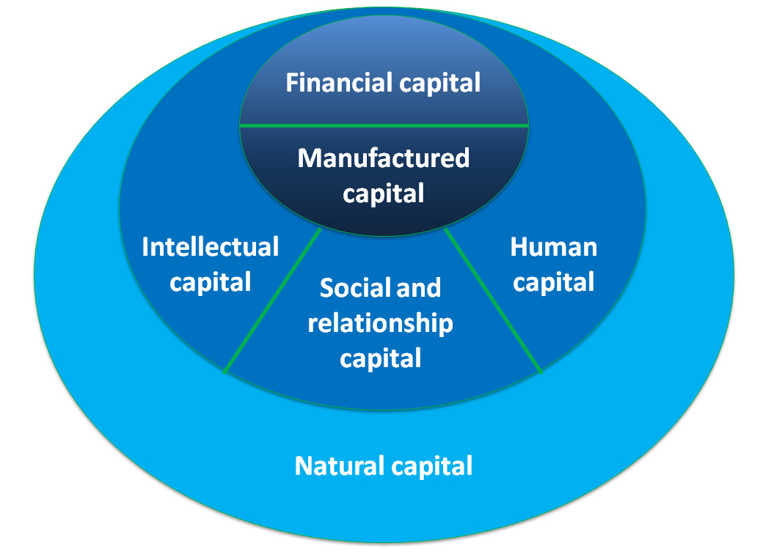
3 Steps to support meaningful reporting of value creation based on intangible capitals
The release of the International Integrated Reporting Framework (Dec. 2013), covering both tangible and intangible forms of capital:
Notes:
Several studies show that a large portion of a company’s value is not captured in the financial statements. There is a need for corporate reporting that integrates the disclosure of information on how companies are creating value from all forms of capital, both tangible and intangible.

Slide 9
3 Steps to support meaningful reporting of value creation based on intangible capitals
The further articulation of clear concepts and definitions for reporting of elements that reflect value creation driven by intangibles:
Intangibles
Human Capital
Sustainability Reporting
Social and Relationship Capital
Natural Capital
Financial Capital
Manufactured Capital
Financial Reporting
Intellectual/ Organizational Capital
Corporate Reporting
Notes:
IIRC Corporate Reporting Dialog: The Corporate Reporting Dialogue (CRD), introduced by the International Integrated Reporting Council (IIRC), brings together organizations that have significant international influence on the corporate reporting landscape. By working together towards a common goal, participants aim to respond to market calls for better alignment and reduced burden in corporate reporting. WICI is well-positioned to support meaningful framework development to support the management and reporting of value creation through intangibles, and the interconnectivity of this information with other key elements of corporate reporting as reflected in our updated MOU with the IIRC.

Slide 10
World Intellectual Capital/Assets Initiative (WICI)
Update Framework:
Provide a regularly updated reporting and disclosure framework as a tool for improved communication between organizations and their stakeholders about “IAbM”
Raise Awareness:
Engage in awareness-building for organizations and investors to help them understand and implement “Intellectual Capital/Assets-based Management” in a constructive way
Develop KPIs:
Identify and promote industry-specific Key Performance Indicators (KPIs) that organizations can freely select from to help them articulate their value creation story.
WICI Framework
Awareness
KPIs
Leverage Data Standards
Elaborate reporting framework concepts, including KPIs, in eXtensible Business Reporting Language (XBRL) - the open international standard for digital business reporting
Data Standards
Global Reporting Framework
Input to Global Framework
Participate actively in the discussion about other internationally recognized reporting and disclosure frameworks, and provide WICI inputs into the emerging globally accepted framework in this field
Notes:
WICI Vision:
WICI recognizes the need for corporate reporting that integrates the disclosure of information on how companies create value over the short, medium and long term through the employment of intangibles.

Slide 11
WICI-KPIs
WICI-KPI Concept is well reflected in the IIRC Discussion Paper.
WICI-KPI Concept
Definition of WICI-KPIs
  Numerical figures related to critical factors of value creation
  Different attributes from indicators required for a specific purpose by a certain civil society
  An informative set of indicators frequently used
Expected attributes of KPIs
  Reinforce the narrative description of a company’s value creation mechanism
  Make visible the value creation story in a given timeline of past-present-future
  Numerical figures, including those quantified through rating methods
  Subset of internal decision making process
  Each KPI can’t be applicable to all companies in general nor in a specific industry
  No intention to define a set of KPIs to be disclosed on a mandatory basis
  Company can choose or add their own indicators
  Company should disclose the same KPIs consistently or change them with explanation
  WICI-KPIs will be reviewed based on change in industry, society and economy

Slide 12
WICI-KPIs for Industries
Electronic components (WICI Japan)
Pharmaceutical (WICI Japan)
Automotive/automobile (WICI Japan)
Telecommunications (WICI Europe + EFFAS CIC)
Software & IT services (EBRC + Gartner)
Mining and Extractive (EBRC + Gartner)
Fashion & Luxury (WICI Europe + EFFAS CIC)
Electricity (WICI Europe + WICI Italy)
All available for free download in the WICI website
(www.wici-global.com)

Slide 13

3 Steps to support meaningful reporting of value creation based on intangible capitals
Provide examples of real world practice:
Form of Capital: |  |  | Google Inc. | Amazon.com Inc. | eBay Inc. | Yahoo! Inc.
C. 2. c. Relationship (Social) capital | Management’s identification of relationships with other organizations and third parties that it regards as important; these can be both tangible (e.g., contracts, license agreements, joint venture agreements, and alliances) and intangible (e.g., long-term relationships with no contractual basis and personal relationships). |  | 2 | 2 | 0 | 3
C. 2. d. Organizational (Structural) capital | Management’s identification of organizational resources not reported on the balance sheet and that are independent of its employees; these can be both tangible (e.g., patents, trademarks, copyrights, formulas and data bases) and intangible (e.g., trade secrets and employed but undocumented methodologies and processes). |  | 1 | 2 | 3 | 1
C. 2. e. Human capital | Management’s identification of any attributes of its workforce (both employees and contractors) that it regards as important; these can be both tangible (e.g., employment contracts) and intangible (e.g., education, skills and abilities, experiences, attitudes, and accomplishments). |  | 3 | 2 | 2 | 2
Notes:
This example WICI framework elements reported through existing disclosures by select companies highlights that this is not new, it is not just an add on, companies already do this just not consistently or comprehensively, and we need to demonstrate this in a more transparent, accessible way.
Opportunity for Conference Board hosted Institute for Sustainable Value Creation (ISVC) to drive change in the US and abroad through providing access and transparency to current practice in reporting of value creation through intangibles.
The ISVC is focused on creating a dashboard to highlight existing, publicly available disclosures of companies that are taking a comprehensive view of all factors that contribute to sustainable value with a focus on intangibles, thereby identifying patterns of successful approaches to creating and communicating sustainable value.

Slide 14
Conclusion
International recognition of the relevance of intangibles in driving corporate value creation has increased due to a number of factors
WICI and its geographical articulations has a unique opportunity to contribute meaningful content to support corporate management and reporting of value creation through intangibles
Communication, positioning and collaboration are critical to enhancing the profile of WICI and its work products

